Slide 1
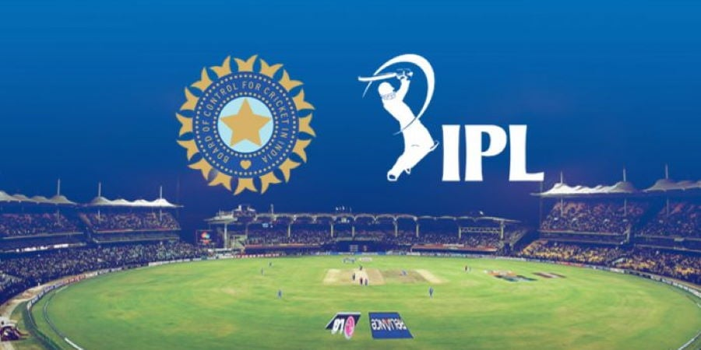
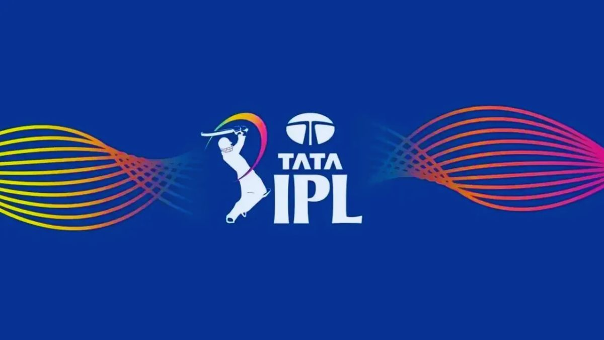

Slide 2

Resume Project Challenge #6
Analyze historical IPL data and provide insights on IPL 2024 for a sports magazine
Company: Sports Basics
Presented By: Nitesh Kumar Prajapati

Slide 3






Agenda
Company and Problem Statement
Task
Request
Data & Tools
Dashboard & Insights
- By Nitesh Kumar Prajapati

Slide 4

Problem Statement
"Sports Basics" is a sports blog company that entered space recently.
They wanted to get more traffic to their website by releasing a special edition magazine on IPL 2024.
This magazine aims to provide interesting insights and facts for fans, analysts, and teams based on the last 3 years’ IPL data.
Task
Design a dashboard with your metrics and analysis. The dashboard presents a concise summary of players and team performance over the past three years.
- By Nitesh Kumar Prajapati

Slide 5
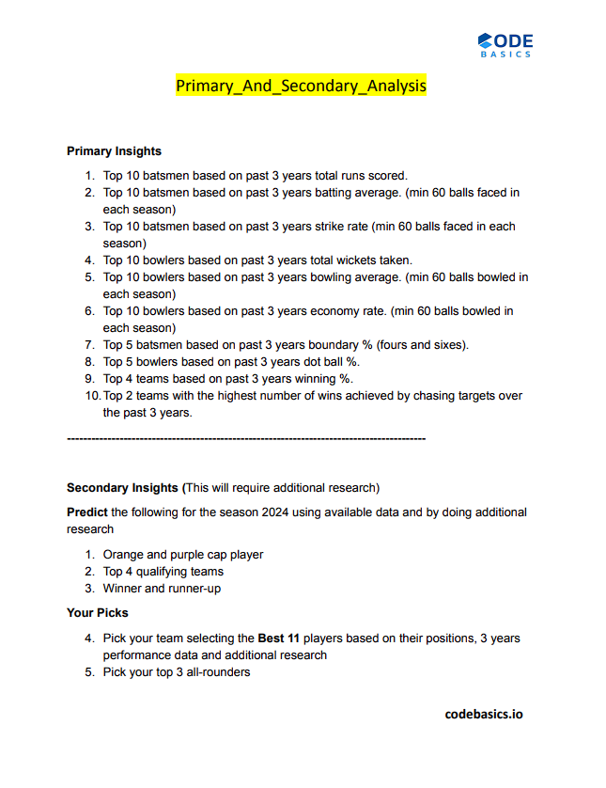
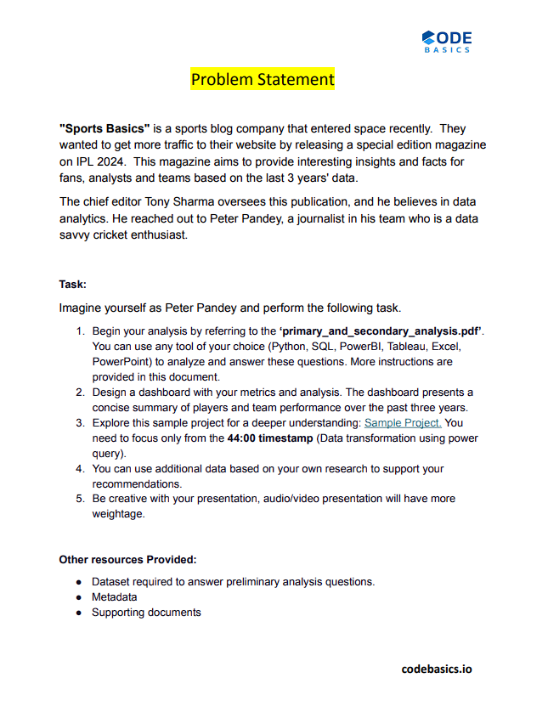
Request
- By Nitesh Kumar Prajapati

Slide 6
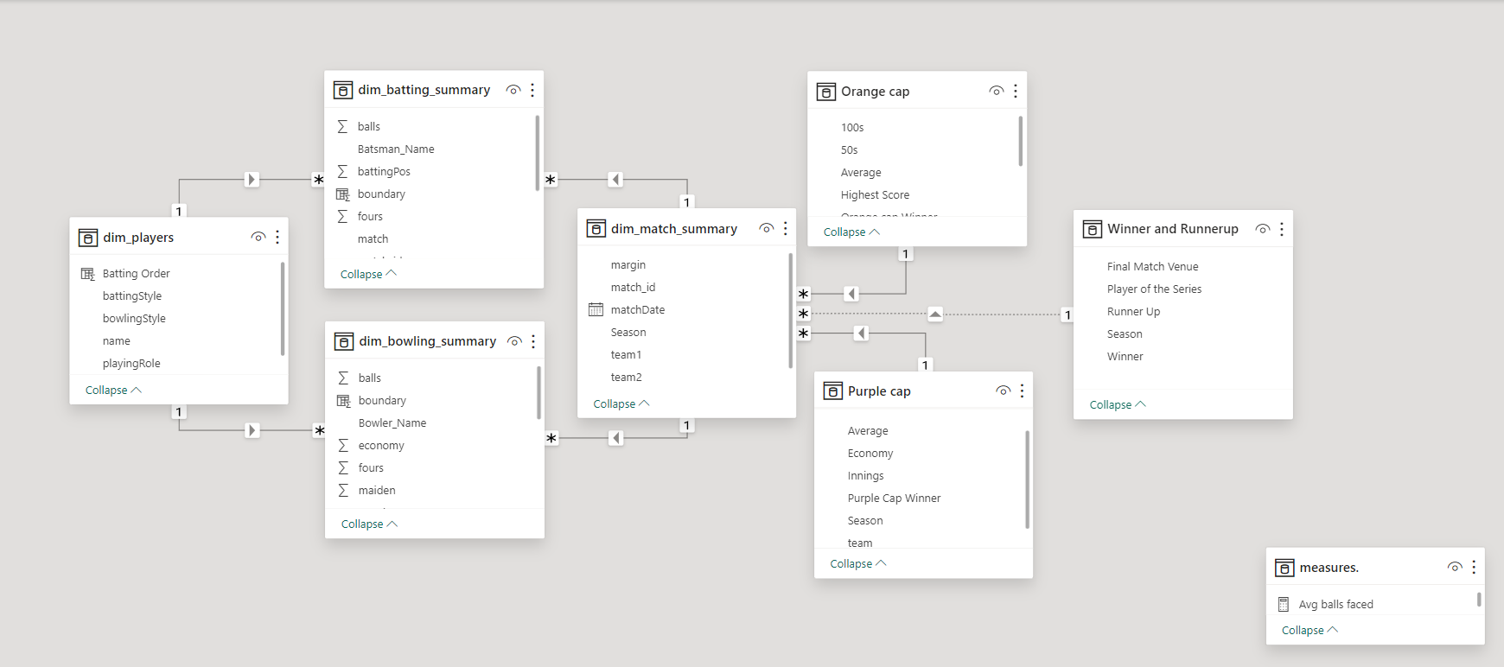




Data & Tools
Tools
- By Nitesh Kumar Prajapati

Slide 7
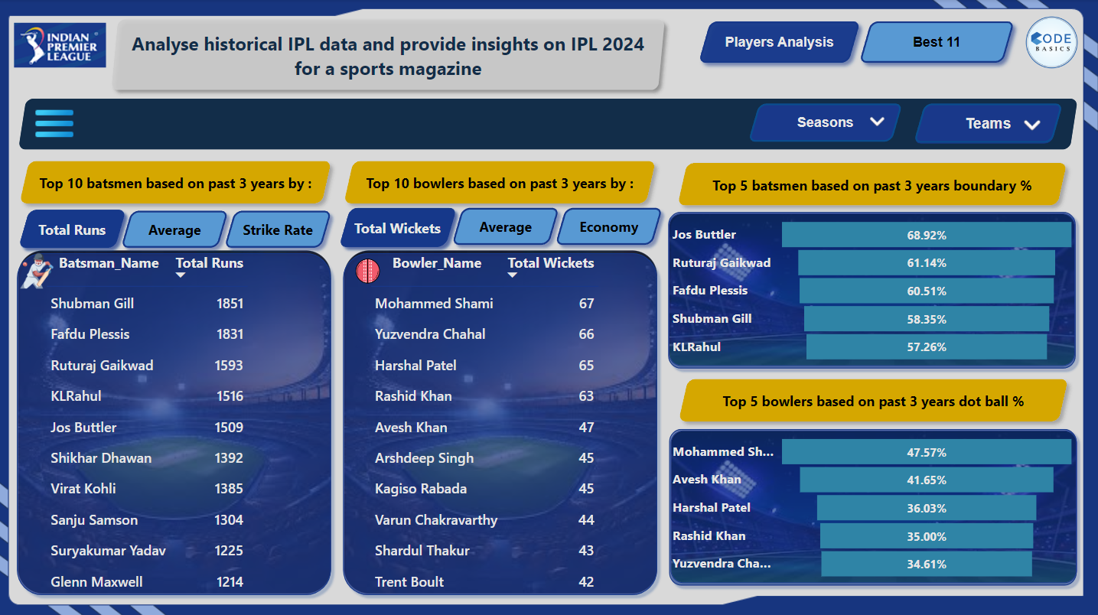
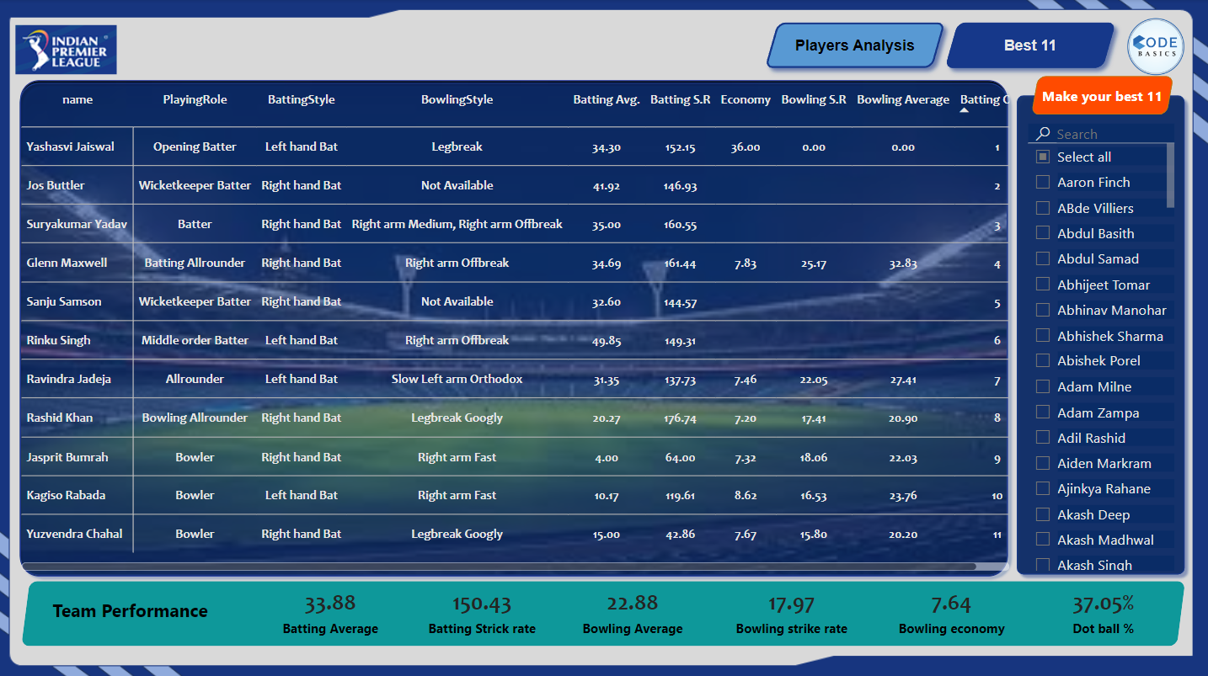
Dashboard & Insights
- By Nitesh Kumar Prajapati

Slide 10

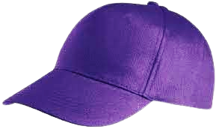
Prediction
Orange Cap
Purple Cap
1. Shubman Gill
1. Yuzvendra Chahal
2. Virat Kholi
2. Mohit Sharma
3. Jos Buttler
3. Kagiso Rabada
- By Nitesh Kumar Prajapati

Slide 11
Prediction
Top 4 Qualifying Teams
1. Chennai Super Kings
2. Rajasthan Royals
3. Kolkata Knight Riders
4. Gujrat Titans
- By Nitesh Kumar Prajapati

Slide 12
THANK
YOU
- By Nitesh Kumar Prajapati

